Slide 1

Measures
of
Central tendency
By
Saujanna Jafreen
Lecturer
Department of Natural sciences

Slide 2
Measure of Central Tendency
A measure of central tendency is a single value that attempts to describe a set of data by identifying the central position within that set of data.

Slide 3
Measures of Central Tendency
At the end of this session the participants should be able to:
 explain why summary measures are needed;
 compute arithmetic mean, median and mode
of a set of data (raw, ungrouped and grouped) and
quote the respective formulae;
 Compute Centiles and explain their uses;
 Describe the uses and limitations of:
mean, median and mode and
their relative merits and demerits

Slide 4
Measure of Central tendency
 Measures of Central Tendency
Measures of central tendency:
Mean
Median
Mode
Mean:
Arithmetic mean (AM)
Weighted mean (WM)
Geometric Mean (GM)
Harmonic Mean (HM)

Slide 5
Computation of Mean, Median and Mode
a. RAW data:
Arithmetic Mean:
AM = Sum of all values/No. of values
_
symbolically, x = Σ x/n
Duration of study hour for 5 students:
x = 4 3 7 4 6 (hours)
_
x = 4+3+7+4+6/5 = 24/5 = 4.8 hours
= Σ x/n

Slide 6
Weighted Arithmetic mean
Sometimes there are situations where the relative importance of the different items is not same. In that case we use weighted arithmetic mean.
The term ‘weight’ stands for the relative importance of different items.

Slide 7
Suppose, monthly salaries of a company in 2015 by category were given below;
The weighted arithmetic mean
( 15,309*100)+(13,293*150)+(9730*175)+(6975*200)
=
100+150+175+200
=(1530900+1993950+1702750+1395000)/625
=10596.16 taka.
Average salary of 625 employee is 10596.16 taka
Level | Salary | No. of employee
1 | 15,309 | 100
2 | 13,293 | 150
3 | 9730 | 175
4 | 6975 | 200

Slide 8
Median:
The value that divides a distribution into two halves.
Procedure:
i. Arrange in order
ii. Find middle value
 for odd number – (n+1)/2 th value
 for even number
Ist middle value= n/2 th value
2nd middle value = (n/2 +1) th value
Median for the data: 4 3 7 4 6
Arranged in ascending order: 3 4 4 6 7
The middle item= (5+1)/2 th item= 3rd item
Value of 3rd item = 4
Therefore, Median = 4.

Slide 9
If there are 6 values e.g. 4 3 7 4 6 9
Median for the data:
Arranged in ascending order: 3 4 4 6 7 9
1st middle item = 6/2 = 3rd item
2nd middle item = 3+1 = 4th item
The value of 3rd and 4th items are: 4 & 6
Median = av. of 4 & 6 = (4+6)/2 = 5.
Mode: The value which occurs most frequently.
Here, 4 occurs most frequently .
Therefore, mode = 4.

Slide 10
Problem:
The following values represent the results of students in a midterm examination.
14,8,9,8,13,14,8,8,12,11,10,7,10,12,12
Calculate average mark.
Calculate the median and the mode.

Slide 11
Mean from Grouped data
Class f x fx CF
2-3 3 2.5 7.5 3
4-5 5 4.5 22.5 8
6-7 1 6.5 6.5 9
Total 9 36.5
Note: x = Mid-Point
X = ∑fx/n = 36.5/9 = 4.05

Slide 12
Mean, Median, Mode from Grouped Data
Height of 100 students are as below:
Height
(cm) f CF
110-115 1 1
115-120 4 5
120-125 10 15
125-130 20 35
130-135 30 65
135-140 20 85
140-145 10 95
145-150 4 99
150-155 1 100
Total 100

Slide 13
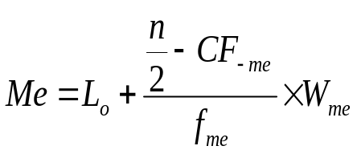



Median for Grouped Data
Formula:
Where,
lower limit of median class
W = class width
N = total no of obsarvations
Cumulative frequency of pre median class
Frequency of median class

Slide 14
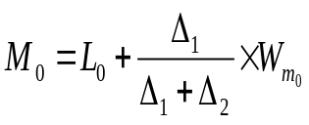



Mode for Grouped Data
Formula:
Where,
lower limit of modal class
W = class width

Slide 15
Median= Median class is 130-135 because CF 50 lies in this class.
then, Me=130+ 100/2-35 ×5
30
=132.5
Mode= modal class is also 130-135 because highest frequency lies in this class.
Mo=130+ 10 ×5
10+10
=132.5

Slide 16
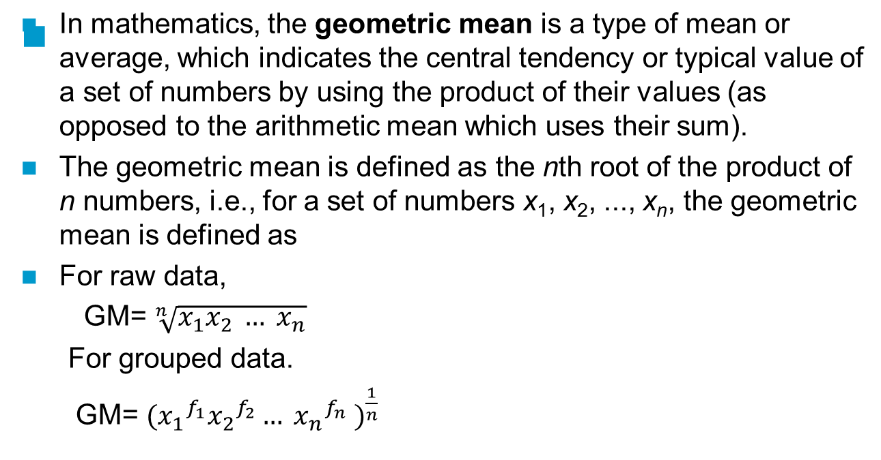
Geometric mean

Slide 17
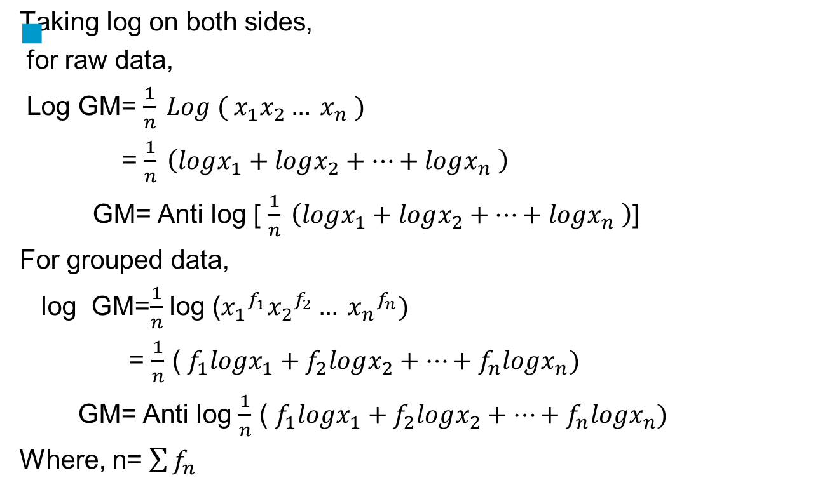

Slide 18
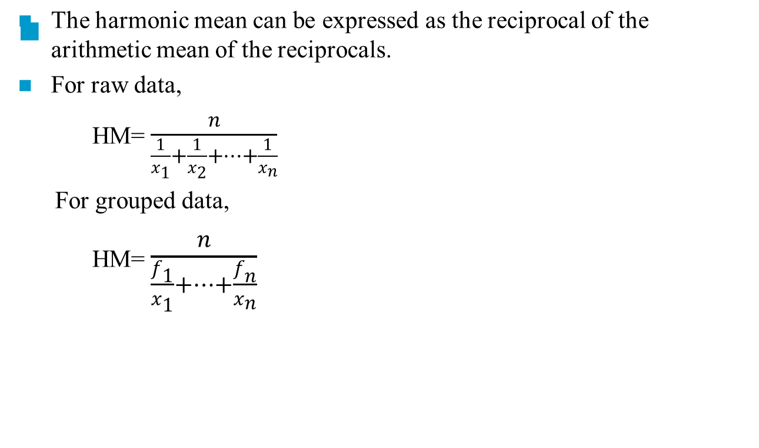
Harmonic mean

Slide 19
Problem:
Table 5 :Frequency distribution
Calculate the harmonic mean of the numbers: 13.5, 14.5, 14.8, 15.2 and 16.1
Solution:
HM= 5/0.3417
=14.63
GM= Anti log (5.82/5)
=14.58
x | 1/x | logx
13.2 | 0.0758 | 1.12
14.2 | 0.0704 | 1.15
14.8 | 0.0676 | 1.17
15.2 | 0.0658 | 1.18
16.1 | 0.0621 | 1.20
Total | 0.3417 | 5.82

Slide 20
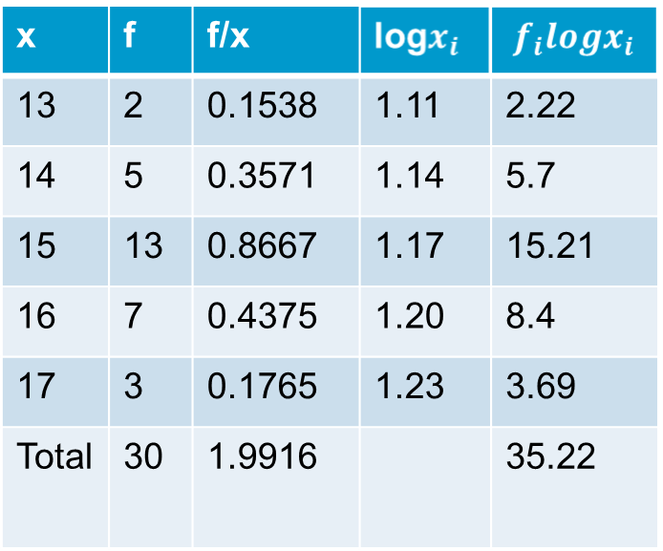
Given the following frequency distribution of ages of first year students of a particular college. Calculate the Harmonic Mean. And geometric mean.
Solution:
HM= 30/1.9916
=15.0631
GM= Anti log(35.22/30)
=14.92

Slide 21
Uses of Central tendency
Mean is applicable to only numerical data.
The median and the mode are the only measures of central tendency that can be used for qualitative ( ordinal) data.
Mode is the only measure can be used meaningfully for ordinal data.

Slide 22
Thank you

